Slide 1
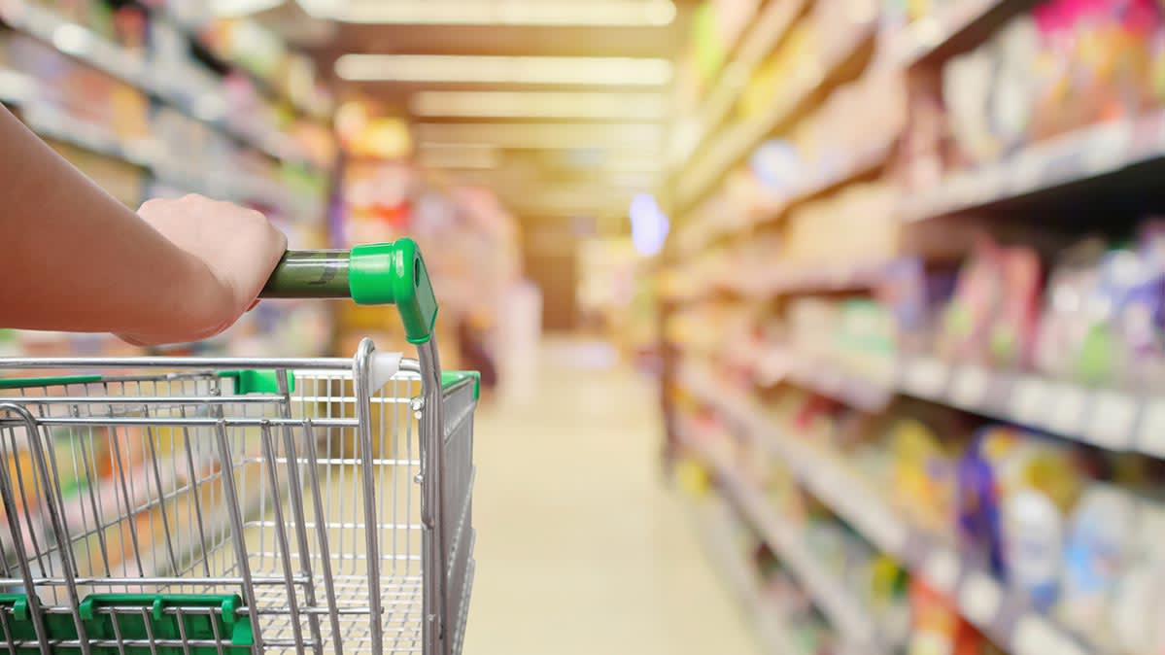

WiSECART
The Smart Shopping Cart Helping Supermarkets Defeat Online Shopping

Slide 2
Introduction
“Smart cart is innovative consumer shopping cart which is designed for customers convenience, fast track their shopping experience, indirectly benefit retailers to increase profit by using behavioral analytics”
From past few years, its noticeable that physical supermarkets are being challenged by online shopping due to its ability to provide convenience, comfort, and efficiency in day-to-day life.
In addition to that, recent crisis of COVID-19 pandemic even accelerated such transitioning.

Slide 3
Motivation
Slow checkouts
Slow movement and picking, more crowded the supermarket.
Lack of targeted advertisement.
Lack of in-store customer tracking

Slide 4
Proposed System
While most supermarkets tried to keep customers dwelling in the shop for longer time, we will focus instead on improving the efficiency of shopping.
Advancement in technology made it possible to convert every shopping cart into a smart cart, by integrating a smart terminal in it.
Smart cart is equipped with RFID sensor. No need to physically touch and scan items, the cart does it all.

Slide 5
In-Store functionality
Shopping list
Tracking
Recommendation + Nutrition details
Self Checkout (RFID sensors)
Optimize the supply chain

Slide 6
Vulnerability
With this smart cart there are enormous advantages but there is concern about the cost of making this high technology features smart cart and whether or not it will have a negative impact on gross profit margins.
The large-scale store can easily bear the prices to make their stores up and running, especially for today’s world with the ongoing pandemic condition and to keep their customers and employee safe.

Slide 7
Metrics
Short term: Keeping in mind the COVID-19 situation, we are expecting that in about 2 months stores are equipped with smart carts.
This will help customers to buy groceries in more hygienic and contactless environment, and assure that the business will be open during current pandemic situation and experience increase in sales per customer per hour
Long term: Improve grocery shopping, we could bring people back customers into stores who liked physical shopping, but hated things like standing in line or having to search the shelves for items.
Increase the number of customers served per hour. More number of customers, more sale and high revenue

Slide 8
Conclusion
Supermarket management will be able to analyze the shopping behaviors of various customers to arrive at valuable business insights and make the changes in supermarket to gain maximum benefits.
Smart cart help customers to navigate, compare, and pick more quickly, buy more and checkout fast, get better understanding of the goods without physically touching them, minimizing the risk of exposure to spreading pandemics thus increasing the capability of supermarkets serving customers and making profit from them.

